Slide 1


Market Analysis of Top 500 Companies in India
Competitive Insights and Key Metrics
This comprehensive analysis delves into the market capitalization and quarterly sales of India's top 500 companies. It provides valuable insights for strategic business and investment decisions in the Indian market.
by Sudarshan Nayak

Slide 2

Introduction
1
Objective
2
Problem Statement
3
Approach
Our analysis aims to uncover market trends and identify industry leaders among India's top 500 companies.
In-depth competitive analysis is crucial for informed business strategies and investment choices in India's dynamic market.
We'll examine market capitalization and quarterly sales to provide a comprehensive view of company performance.

Slide 3
Dataset Overview
Dataset Scope
Analysis Goals
Data Integrity
Our analysis covers 500 top Indian companies, focusing on market capitalization and quarterly sales figures.
We aim to rank companies, identify industry leaders, and uncover significant market trends and patterns.
Rigorous data cleaning and validation ensure the accuracy and reliability of our insights and conclusions.

Slide 4

Key Metrics Summary
Total Companies Analyzed
489
Average Market Cap
₹27,708.96 Crores
Highest Market Cap
₹5,83,436.72 Crores (Reliance Industries)
Average Quarterly Sales
₹3,644.12 Crores
Maximum Quarterly Sales
₹1,10,666.93 Crores

Slide 5
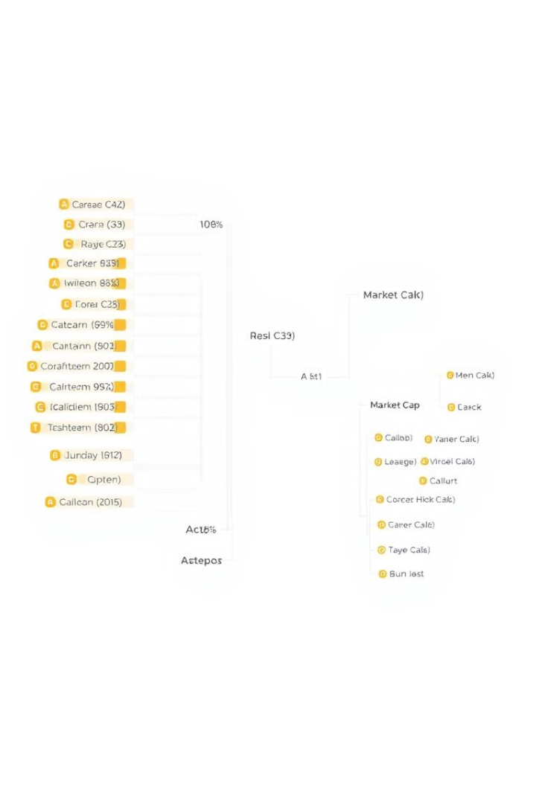
Market Cap Categories
Very Large Cap
Above ₹5,00,000 Crores. These giants dominate the market, driving significant value and influencing trends.
Large Cap
₹2,00,000–₹5,00,000 Crores. Established players with strong market presence and consistent performance.
Medium Cap
₹1,00,000–₹2,00,000 Crores. Growing companies with potential for significant market impact in the future.
Small Cap
Below ₹1,00,000 Crores. Numerous companies with high growth potential, offering diverse investment opportunities.

Slide 6




Top Companies by Market Cap and Sales
Market Cap Leaders
Reliance, TCS, HDFC Bank, ITC, and HDFC lead in market capitalization, showcasing investor confidence.
Sales Champions
IOCL, Reliance, Tata Motors, BPCL, and HPCL top the list in quarterly sales performance.
Dual Excellence
Companies ranking high in both metrics demonstrate strong market leadership and operational efficiency.

Slide 7




High Market Cap, Low Sales Companies
ITC
Strong brand value and diversified portfolio contribute to high market capitalization despite lower sales.
Hindustan Unilever
Consumer goods giant with established brand loyalty, driving high market value beyond sales figures.
ICICI Bank
Financial services leader with significant growth potential, reflected in its high market capitalization.

Slide 8

Market Cap to Sales Ratio
1
Ratio Significance
The Market Cap to Sales Ratio highlights companies with high market value relative to sales.
2
Interpretation
A high ratio suggests strong market confidence or strategic positioning in high-growth sectors.
3
Leading Companies
Redington India and Rakesh Exports demonstrate exceptionally high Market Cap to Sales Ratios.
4
Investment Implications
Companies with high ratios may offer growth potential but require careful analysis of underlying factors.

Slide 9
Findings and Strategic Recommendations
Key Findings
Investor Recommendations
Business Strategies
Very Large Cap companies dominate both Market Cap and Sales metrics.
Benchmark against top performers in your sector for competitive insights and growth strategies.
Focus on companies with high Market Cap to Sales Ratios for potential growth opportunities.
Small Cap segment offers diverse growth opportunities for investors.

Slide 10

Conclusion
1
Comprehensive Insights
This analysis provides a detailed snapshot of India's top 500 companies' competitive landscape.
2
Strategic Value
Valuable insights guide strategic investment and business growth decisions in the Indian market.
3
Future Directions
A longitudinal study of growth trends could forecast future market leaders and emerging sectors.

